Slide 1
Chapter 3 Understanding the Consumer
Simon Hudson

Slide 2
Topics Covered
Profiling consumers
Motivations
Constraints

Slide 3
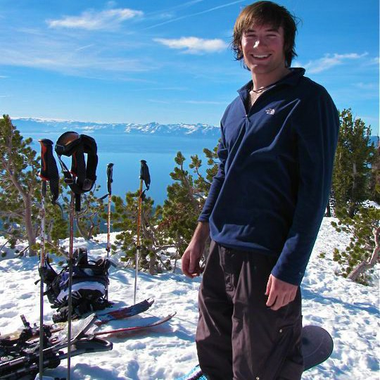
Spotlight: X-Games takes X-treme sports to X-citing new level
Encompass skateboarding and motocross and winter sports (snowboarding, skiing, snowmobiling)
AFP: coordinate between ESPN Live TV, the athletes, the judges…
Marketing: social media, online advertising

Slide 4
Profiling consumers
Ski travelers: male, younger and affluent
Ski travelers VS. regular travelers
Generational differences

Slide 5
Winter sports participation rates in the U.S. 2008-2013
Source: Adapted from Snowsports Industries America, 2014a

Slide 6
Winter sport tourists versus regular travelers in the U.S.
 | U.S. tourists | Winter sport tourists
Male | 50% | 66%
Ages 18-44 | 54% | 63%
>$100,000 annual income | 24% | 49%
Source: Adapted from PhocusWright,2013

Slide 7
Age Demographics- skiers vs. snowboard
Source: Adapted from Snowsports Industries America, 2014a

Slide 8
Generational differences in skiing and snowboarding
Total Participants | Snowboard | Alpine | Freeski
Total Participants (all ages) 1+ times | 7,351,000 | 8,243,000 | 5,368,000
Baby Boomers (55+) 1+ times | 1% | 6% | 3%
Gen X (35 to 54) 1+ times | 19% | 33% | 24%
Gen Y (18 to 34) 1+ times | 51% | 37% | 50%
Gen Z (under 18) 1+ times | 29% | 24% | 23%
Female Participants
Total Participants (all ages) 1+ times | 2,396,000 | 3,305,000 | 1,945,000
Baby Boomers (55+) 1+ times | 0% | 3% | 2%
Gen X (35 to 54) 1+ times | 17% | 27% | 20%
Gen Y (18 to 34) 1+ times | 60% | 40% | 55%
Gen Z (under 18) 1+ times | 23% | 30% | 24%
Male Participants
Total Participants (all ages) 1+ times | 4,955,000 | 4,938,000 | 3,423,000
Baby Boomers (55+) 1+ times | 1% | 9% | 3%
Gen X (35 to 54) 1+ times | 20% | 36% | 26%
Gen Y (18 to 34) 1+ times | 47% | 35% | 47%
Gen Z (under 18) 1+ times | 32% | 20% | 23%
Source: Adapted from Snowsports Industries America, 2014a

Slide 9
Profiling participants who both ski and snowboard
Source: Adapted from PhocusWright,2013

Slide 10
Last Snowsports Holiday Behaviour
 | %
This trip was my first snowsports holiday | 27
I booked the holiday as a package (eg includes travel and accommodation) | 25
This trip was organized by my school/university | 20
I booked transport and accommodation separately | 17
I paid a for ski/snowboard school | 17
I took advantage of a deal or special offer | 17
I travelled outside of peak season to save money | 16
I paid for private ski/snowboard instructor lessons | 15
I brought my own skis or snowboard from the UK | 13
I tried another activity aside from skiing/snowboarding (eg ice climbing, dogsledding, tobogganing, paragliding, snowshoeing) during my trip | 12
A holiday rep/ski host escorted me around the slopes for free | 11
Source: Adapted from Mintel, 2014

Slide 11
Motivations
Ski passion and drive factors
Safety, affiliation, esteem…
Explain skier behavior
Tikalsky and Lahren (1988)
Williams and Dossa (1995)
Motivations: sports, social and vacation

Slide 12
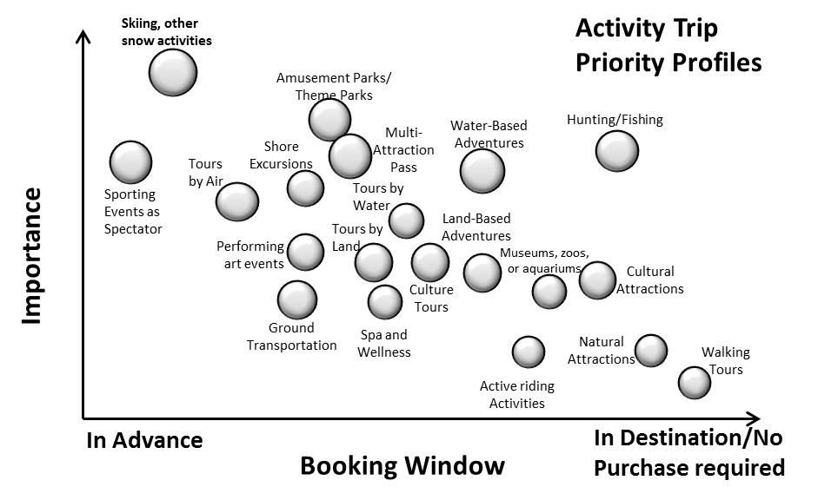
Relative importance of skiing compared to other activities
Source: Adapted from PhocusWright,2011

Slide 13
Factors Driving Ski Destination Selection
Source: Adapted from PhocusWright,2013

Slide 14
Where British skiers traveled in 2013/14
Source: Adapted from Crystal Ski Holiday,2014

Slide 15
Attitudes towards Snowsports Holidays
 | %
The natural landscape of a snowsports holiday appeals to me | 49
I would prefer to visit a resort that offered a range of other activities (eg ice climbing, dogsledding, tobogganing, paragliding, snowshoeing) | 31
I would practice/learn on an artificial/indoor slope in the UK before a snowsports holiday | 31
The physical challenge of a snowsports holiday appeals to me | 29
I would only travel to a resort with guaranteed snow cover | 28
I would only go to a well-known ski destination | 26
I would travel to an emerging ski destination (eg Bulgaria) to save money | 23
I would hesitate to take a snowsports holiday that did not include a rep/ski host | 15
I am concerned about the environmental impact of snowsports | 8
None of these | 4
Source: Adapted from Mintel, 2014

Slide 16
Profile - Gstaad: Marketing to millennials
Huge market
Keys to attracting, satisfying and retaining millennials
Choice making: social media, online reviewing and apps…

Slide 17
Constraints
Constraints for participant and non-participant
Effect of ethnicity
Macro- and micro- level

Slide 18
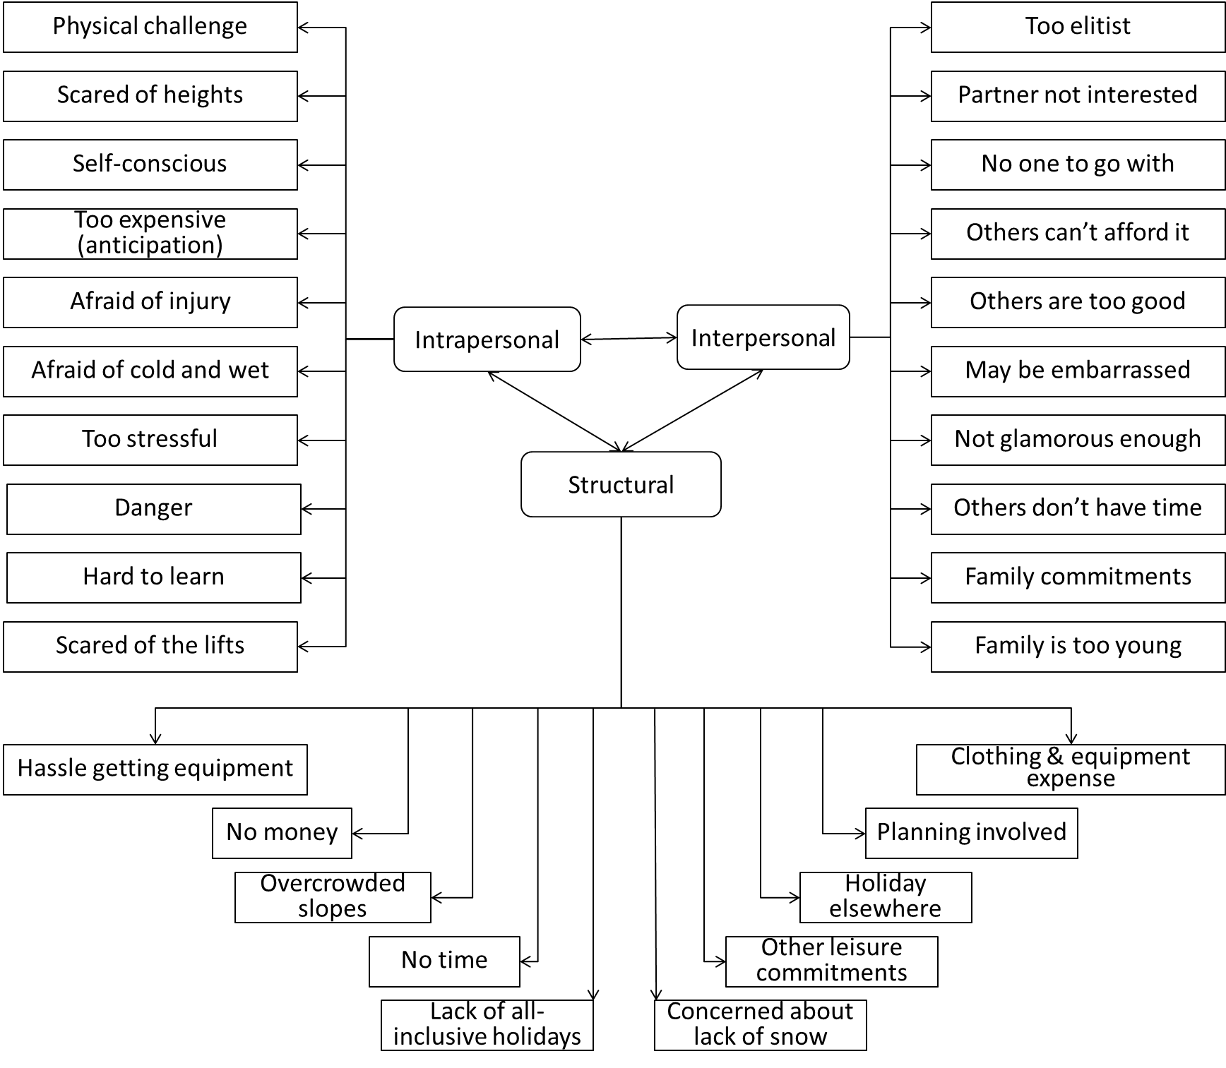
Constraints to skiing participation
Source: Adapted from Gilbert and Hudson, 2000

Slide 19
Perceived constraints to skiing
Constraint | Mean Value
Clothing and equipment are too expensive | 3.75
Anticipation of expense | 3.55
Lack of low-cost all-inclusive holidays | 3.48
Prefer to take a holiday elsewhere | 3.16
Do not have enough money | 3.14
Others do not have the money to go with me | 2.89
The slopes are too crowded | 2.79
Concern about the lack of snow | 2.76
Too much hassle buying or renting equipment | 2.63
Too much planning involved | 2.57
Source: Adapted from Gilbert and Hudson, 2000

Slide 20
Leisure Constraints Model
Source: Adapted from Walker and Virden, 2005

Slide 21
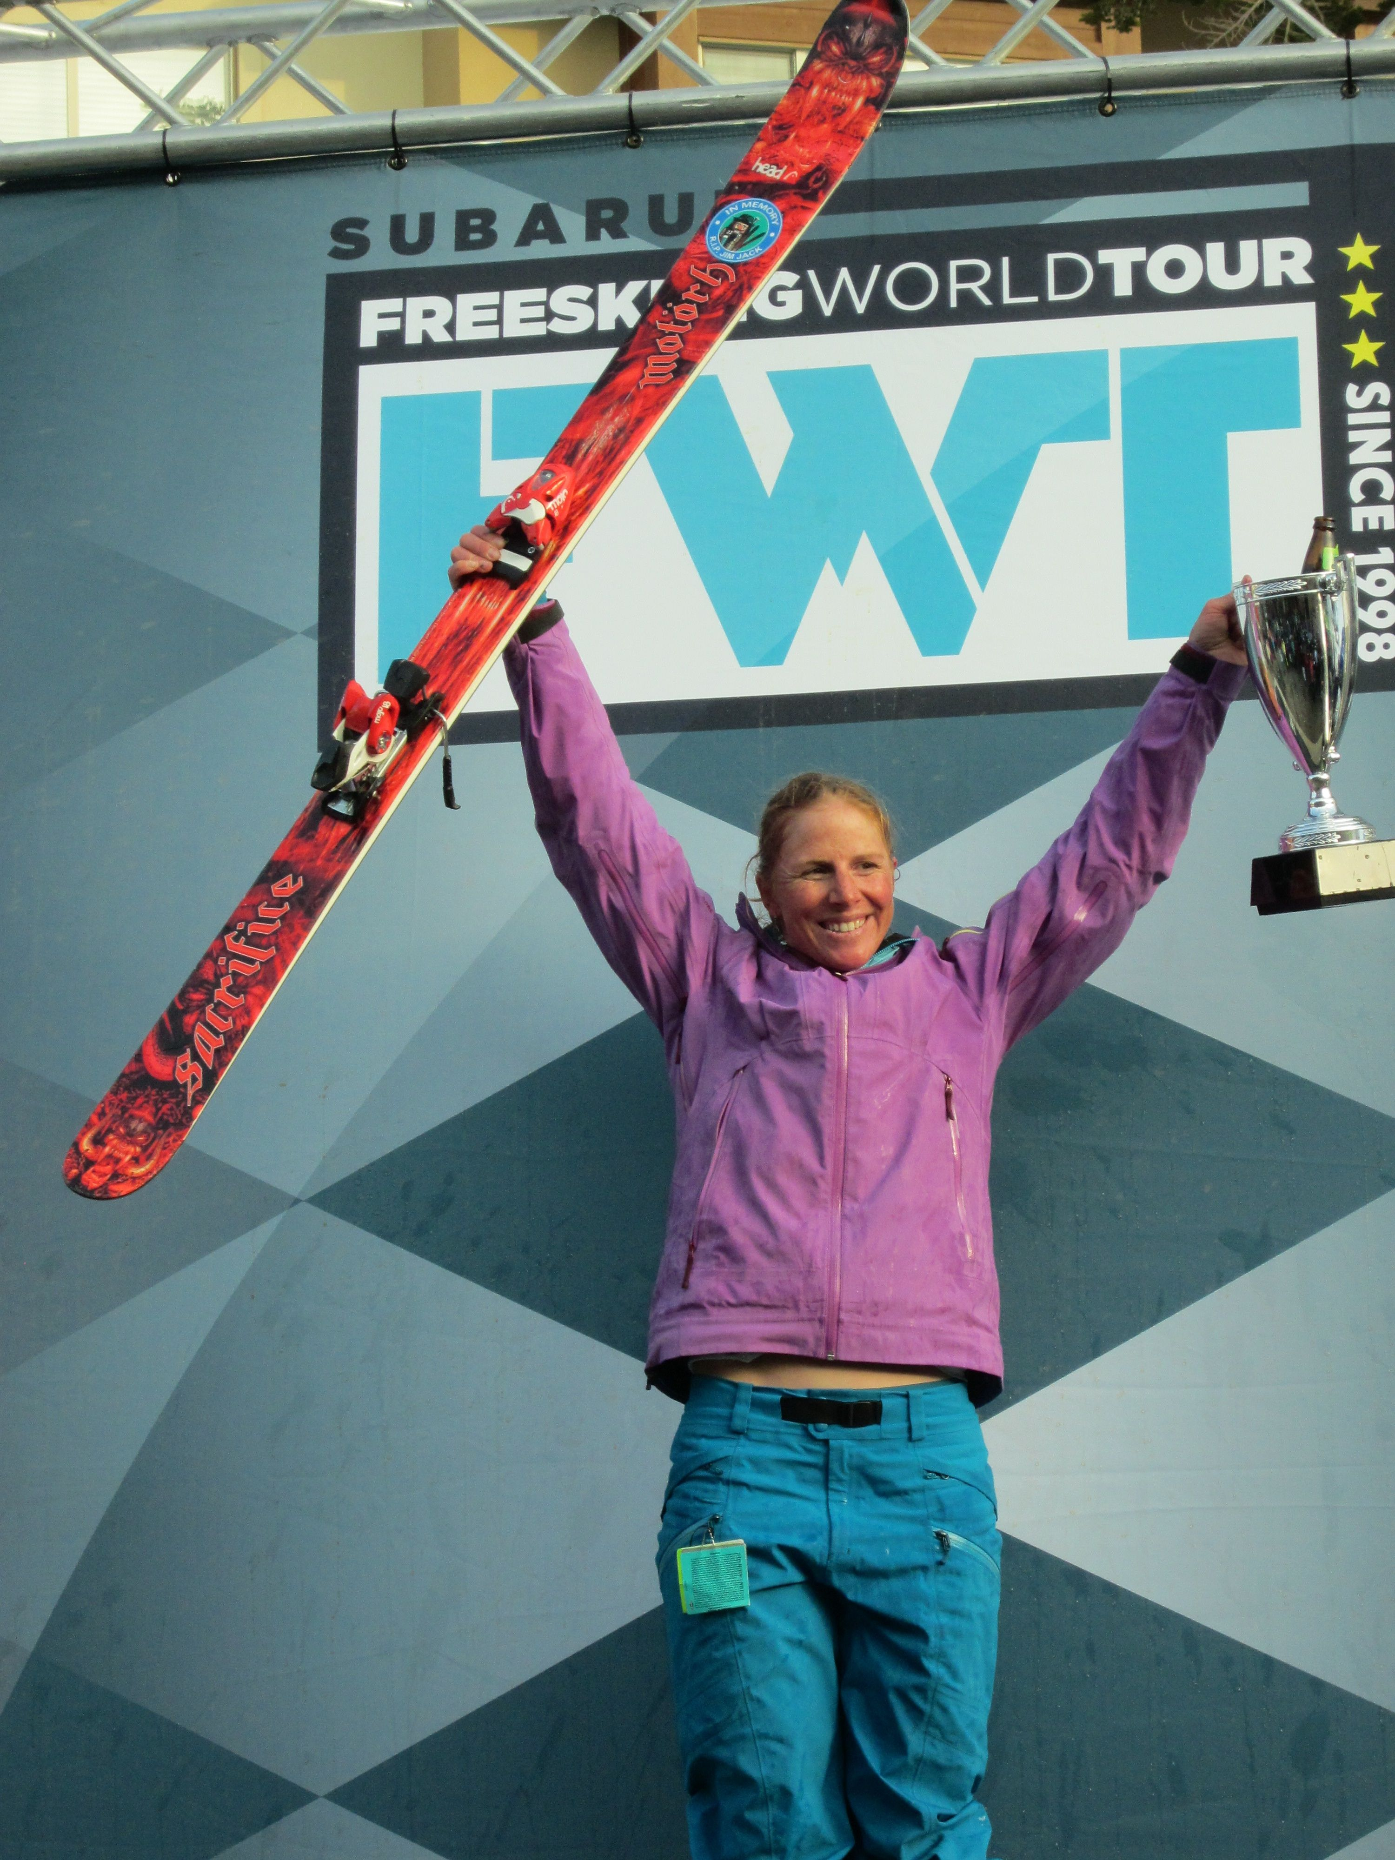
Case study - Freeski female style
Elevate Women’s Ski Camp
Three top female freeskiers
Change profile of women in skiing
Revolution

